Slide 1

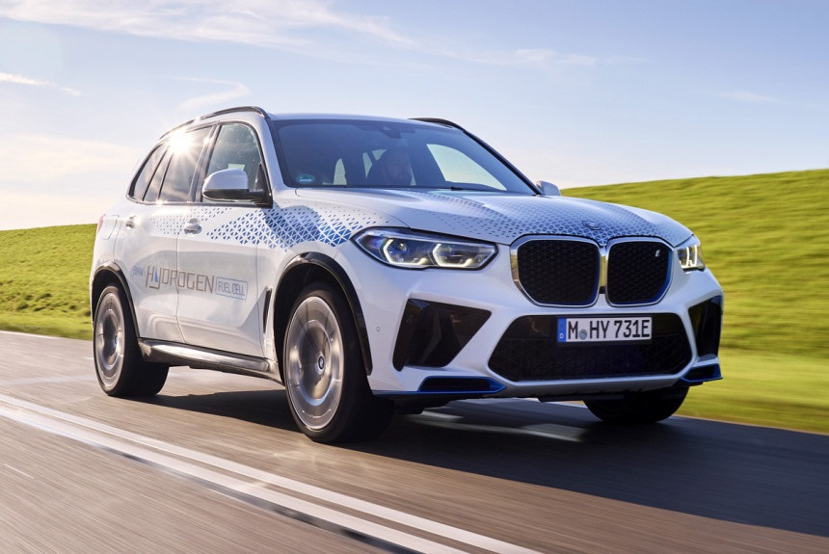

Hydrogen and Ethanol cars
&

Slide 2

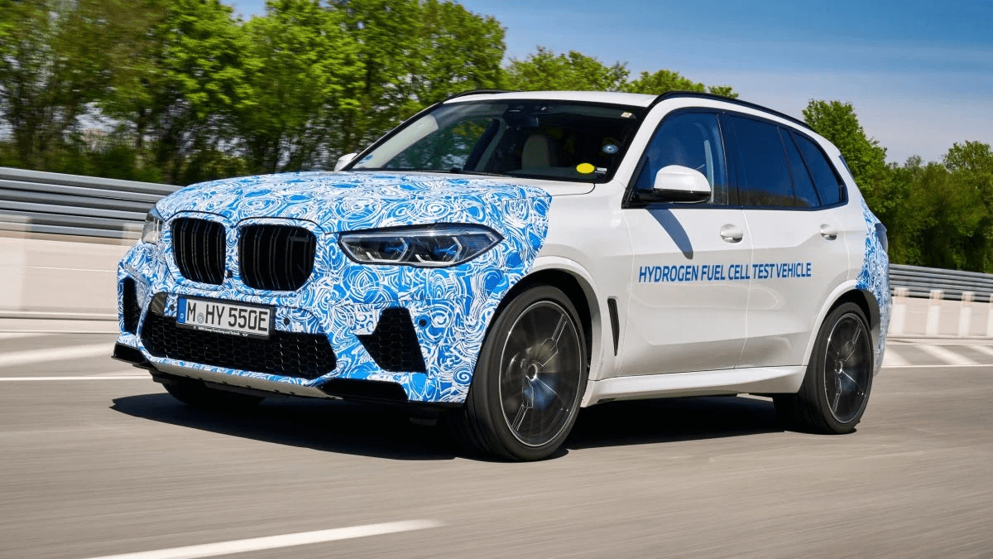
Hydroge Cars

Slide 3
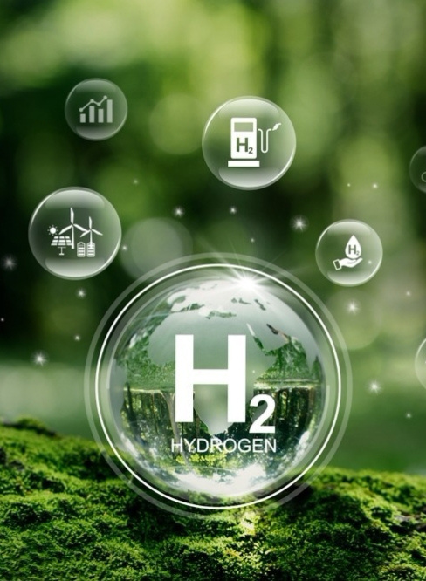
INTRODUCTION TO HYDROGEN
& It's Use in Cars .
Hydrogen (H2) is the lightest chemical element.
It is often found in the form of compounds such as water (H₂O) and hydrocarbons.
It is a colorless, odorless, flammable gas .
Used as fuel in fuel cell cars.
Stored in compressed tanks → produces electricity to power the motor.

Slide 4
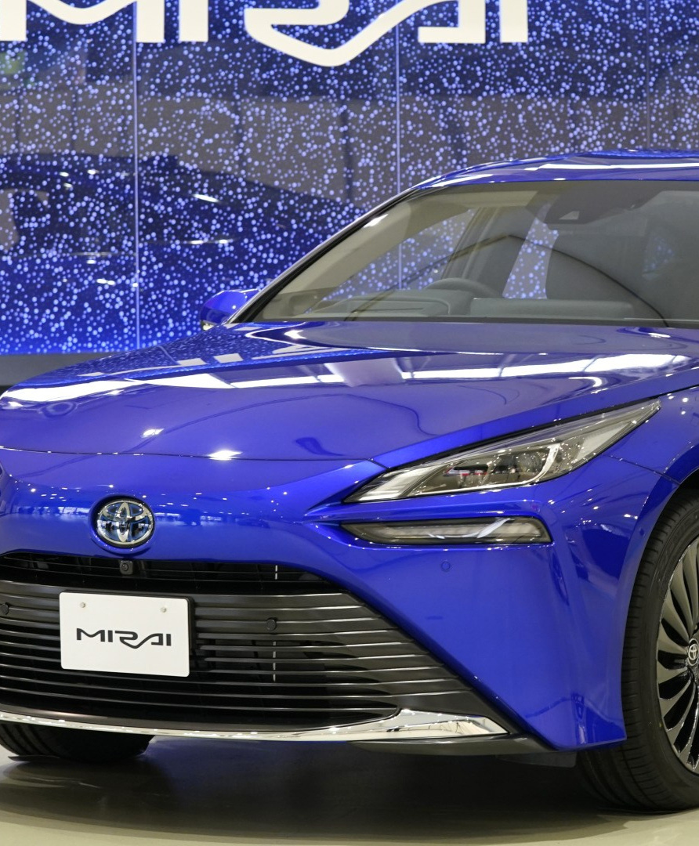


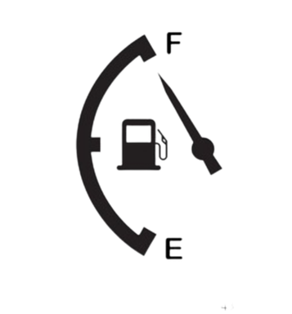


WHY HYDROGEN VEHICLES?
Eco-friendly:
High efficiency:
Only water as emission, no CO2 or pollutants.
Fuel cells convert chemical energy directly to electricity.
Long range:
Fast refueling:
Comparable to gasoline cars.
Hydrogen tanks can be filled in 3–5 minutes.
Silent operation:
Electric motor produces
less noise.

Slide 5
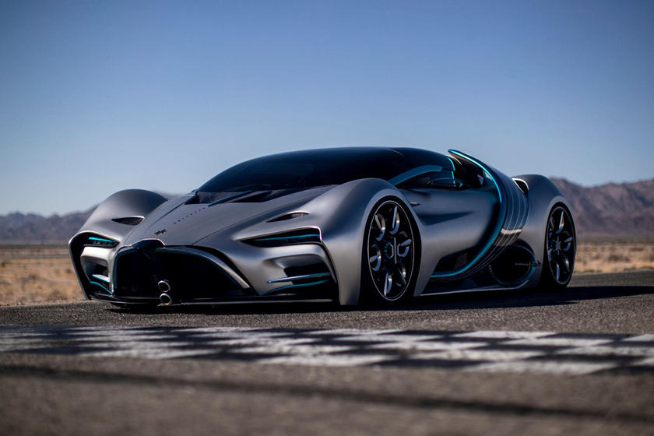
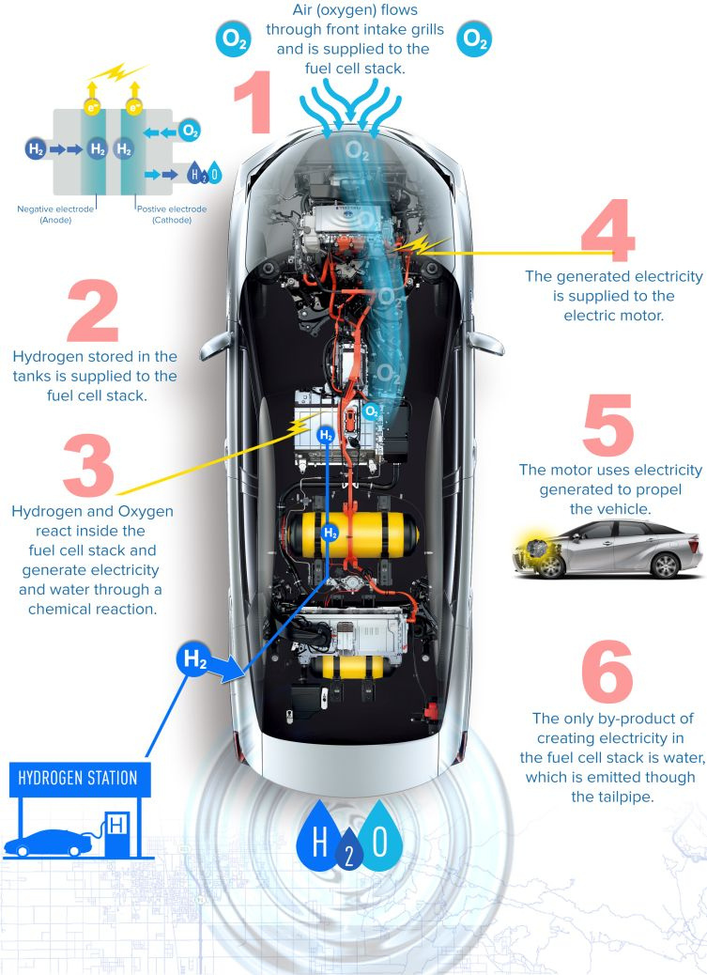
HOW HYDROGEN CARS WORK
Hydrogen is stored in compressed tanks → enters fuel cell → reacts with oxygen → produces electricity.
Electricity then flows to the motor → motor turns the wheels → moves the car.
Output: water only.

Slide 6
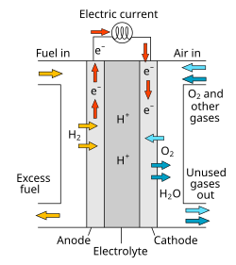
FUEL CELLS – HOW THEY WORK
Convert chemical energy of hydrogen directly into electricity.
Process:
1. Hydrogen enters Anode → releases protons (H+) and electrons (e-).
2. Electrons travel through circuit → produce electricity.
3. Oxygen reacts at Cathode → forms water.
Equation: 2H2 + O2 → 2H2O + electricity
Features: eco-friendly, high efficiency, only water as output.

Slide 7
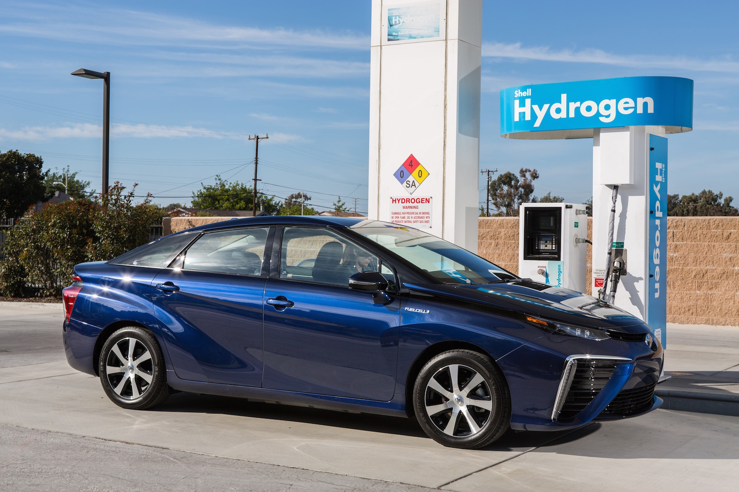

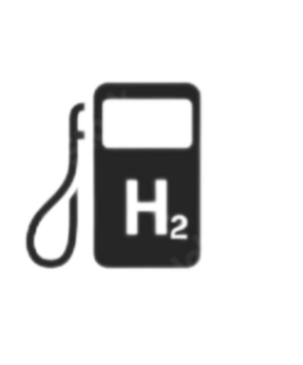

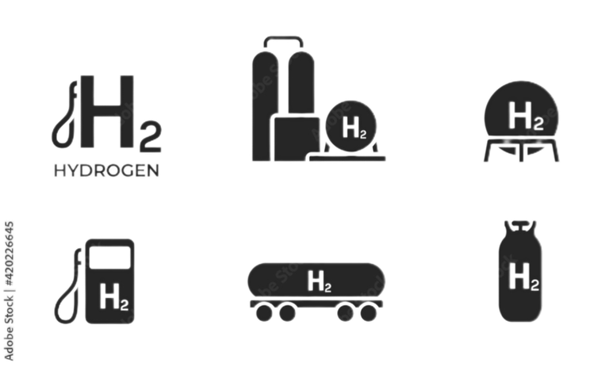
DISADVANTAGES
Maintenance costs:
The manufacturing cost is high.
Few Hydrogen Stations:
Hydrogen refueling stations are still very rare and expensive to build, making it difficult for drivers to find a place to refill their cars.
DIFFICULT TO STORE:
HARD TO TRANSPORT SAFELY:
Hydrogen is the lightest gas and easily escapes. It must be
stored under very high pressure or at extremely low temperatures ,
which requires heavy and costly tanks.
Hydrogen is highly flammable and can leak easily, so it needs
special trucks and strong pipelines to be
transported safely.

Slide 8

Ethanol Cars

Slide 9
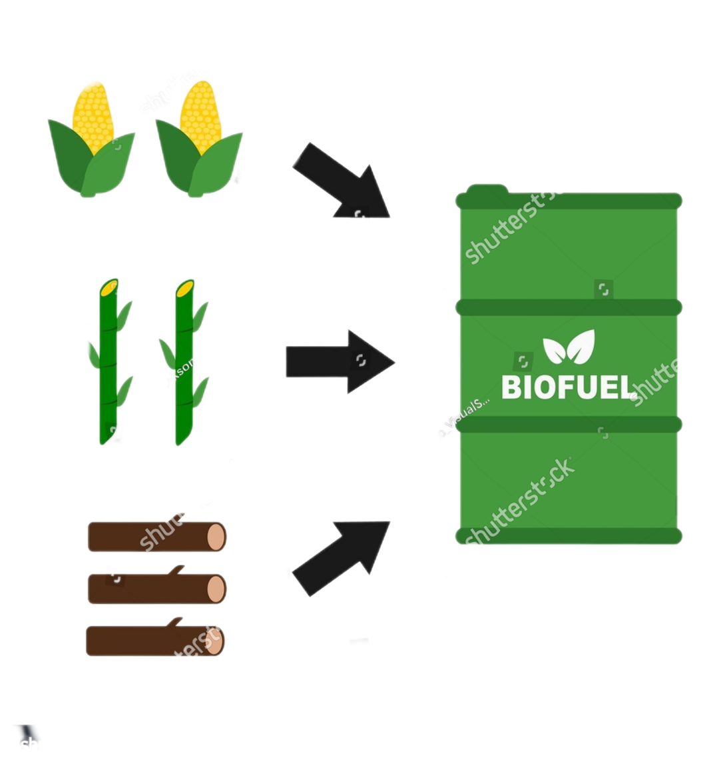
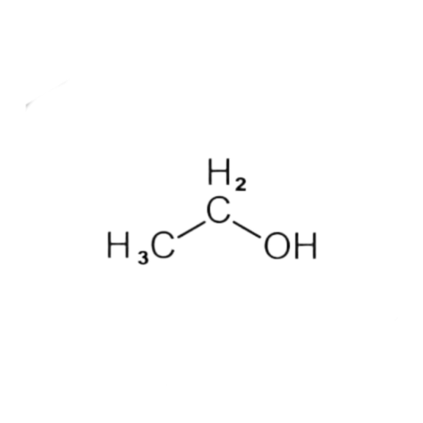


BIOFUELS
Biofuels are fuels produced from renewable organic materials like wood, sugarcane, and corn.
Types of biofuels:
Ethanol
Used as an alternative fuel for cars, often blended with gasoline like E85.
Biodiesel:
Made from vegetable oils or animal fats, used in diesel engines.
Biogas:
Produced from organic matte
decomposition , used for
electricity or as gas fuel .
Now, let's focus on ethanol and its use in cars.

Slide 10

WHAT IS ETHANOL
Ethanol is a type of alcohol made from plants like corn or sugarcane.
It is used as an alternative fuel for cars, often blended with gasoline like E85.
Boosts engine power and keeps the engine cooler during extreme driving.
ITS USED IN CARS
Widely used in racing and drift cars to improve power and efficiency.
E85 contains 85% ethanol and 15% gasoline, making it the best choice for high-performance cars and drifting.
Ethanol cars work like gasoline
engines but are modified
to handle ethanol.
Different types of ethanol can be used
depending on needs (E10, E85).

Slide 11
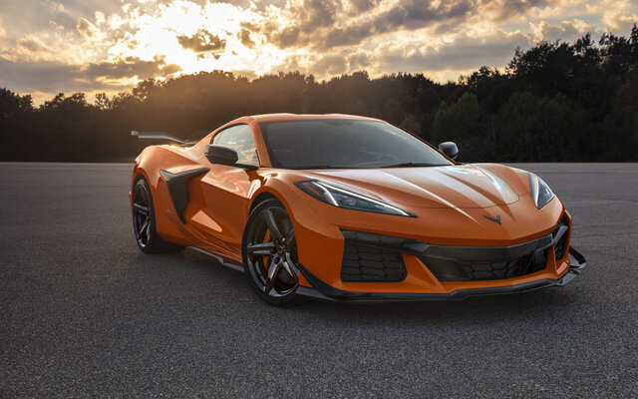


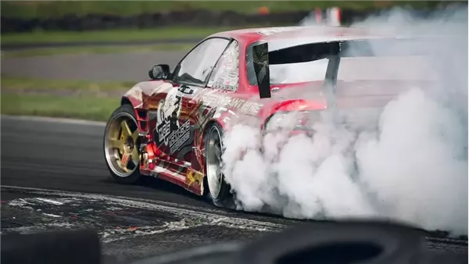

WHY ETHANOL CARS
Renewable and environmentally friendly fuel .
Provides better performance in some
modified cars.
Can be produced locally from plants.

Slide 12
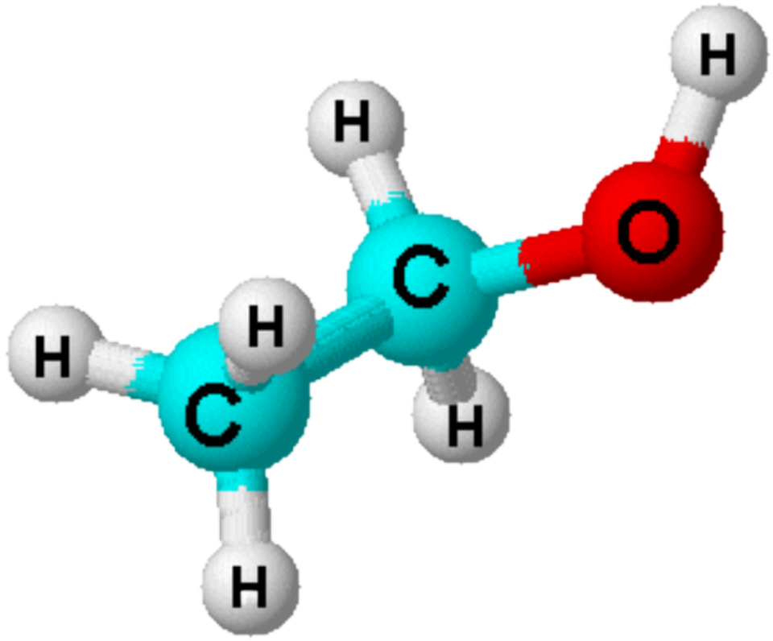
Chemical and Physical Characteristics of Ethanol
PROPERTY
Details
Scientific name
Ethanol
Chemical formula
C₂H₆O or CH₃CH₂OH
Molar mass
46.07 g/mol
Mass of one molecule
7.65 × 10⁻²⁶ kg
C₂H₆O
Carbon (C) = 2
Atomic combustion
Hydrogen (H) = 6
Oxygen (O) = 1

Slide 13
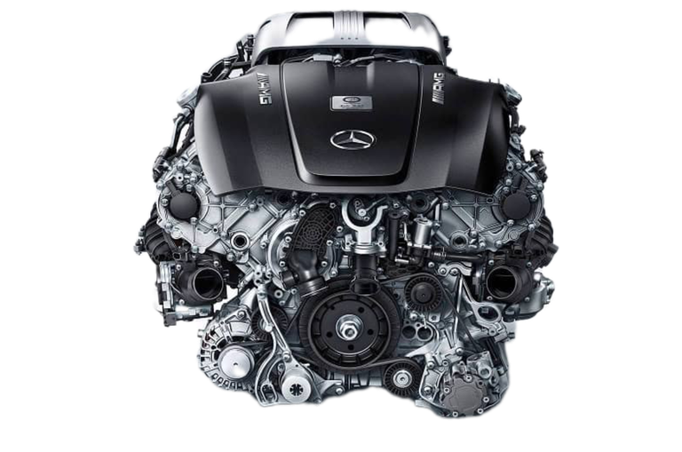



Challenges of Ethanol-Powered Cars
1
Lower Energy Density – Requires more fuel to travel the same distance.
2
Compatibility Issues – Older engines may corrode due to ethanol’s acidity.
3
Cold Start Problems – Harder to ignite in low temperatures.
4
Higher Fuel Consumption – Uses more fuel compared to gasoline.
5
Storage Concerns – Ethanol absorbs water easily, affecting tanks and fuel systems.

Slide 14
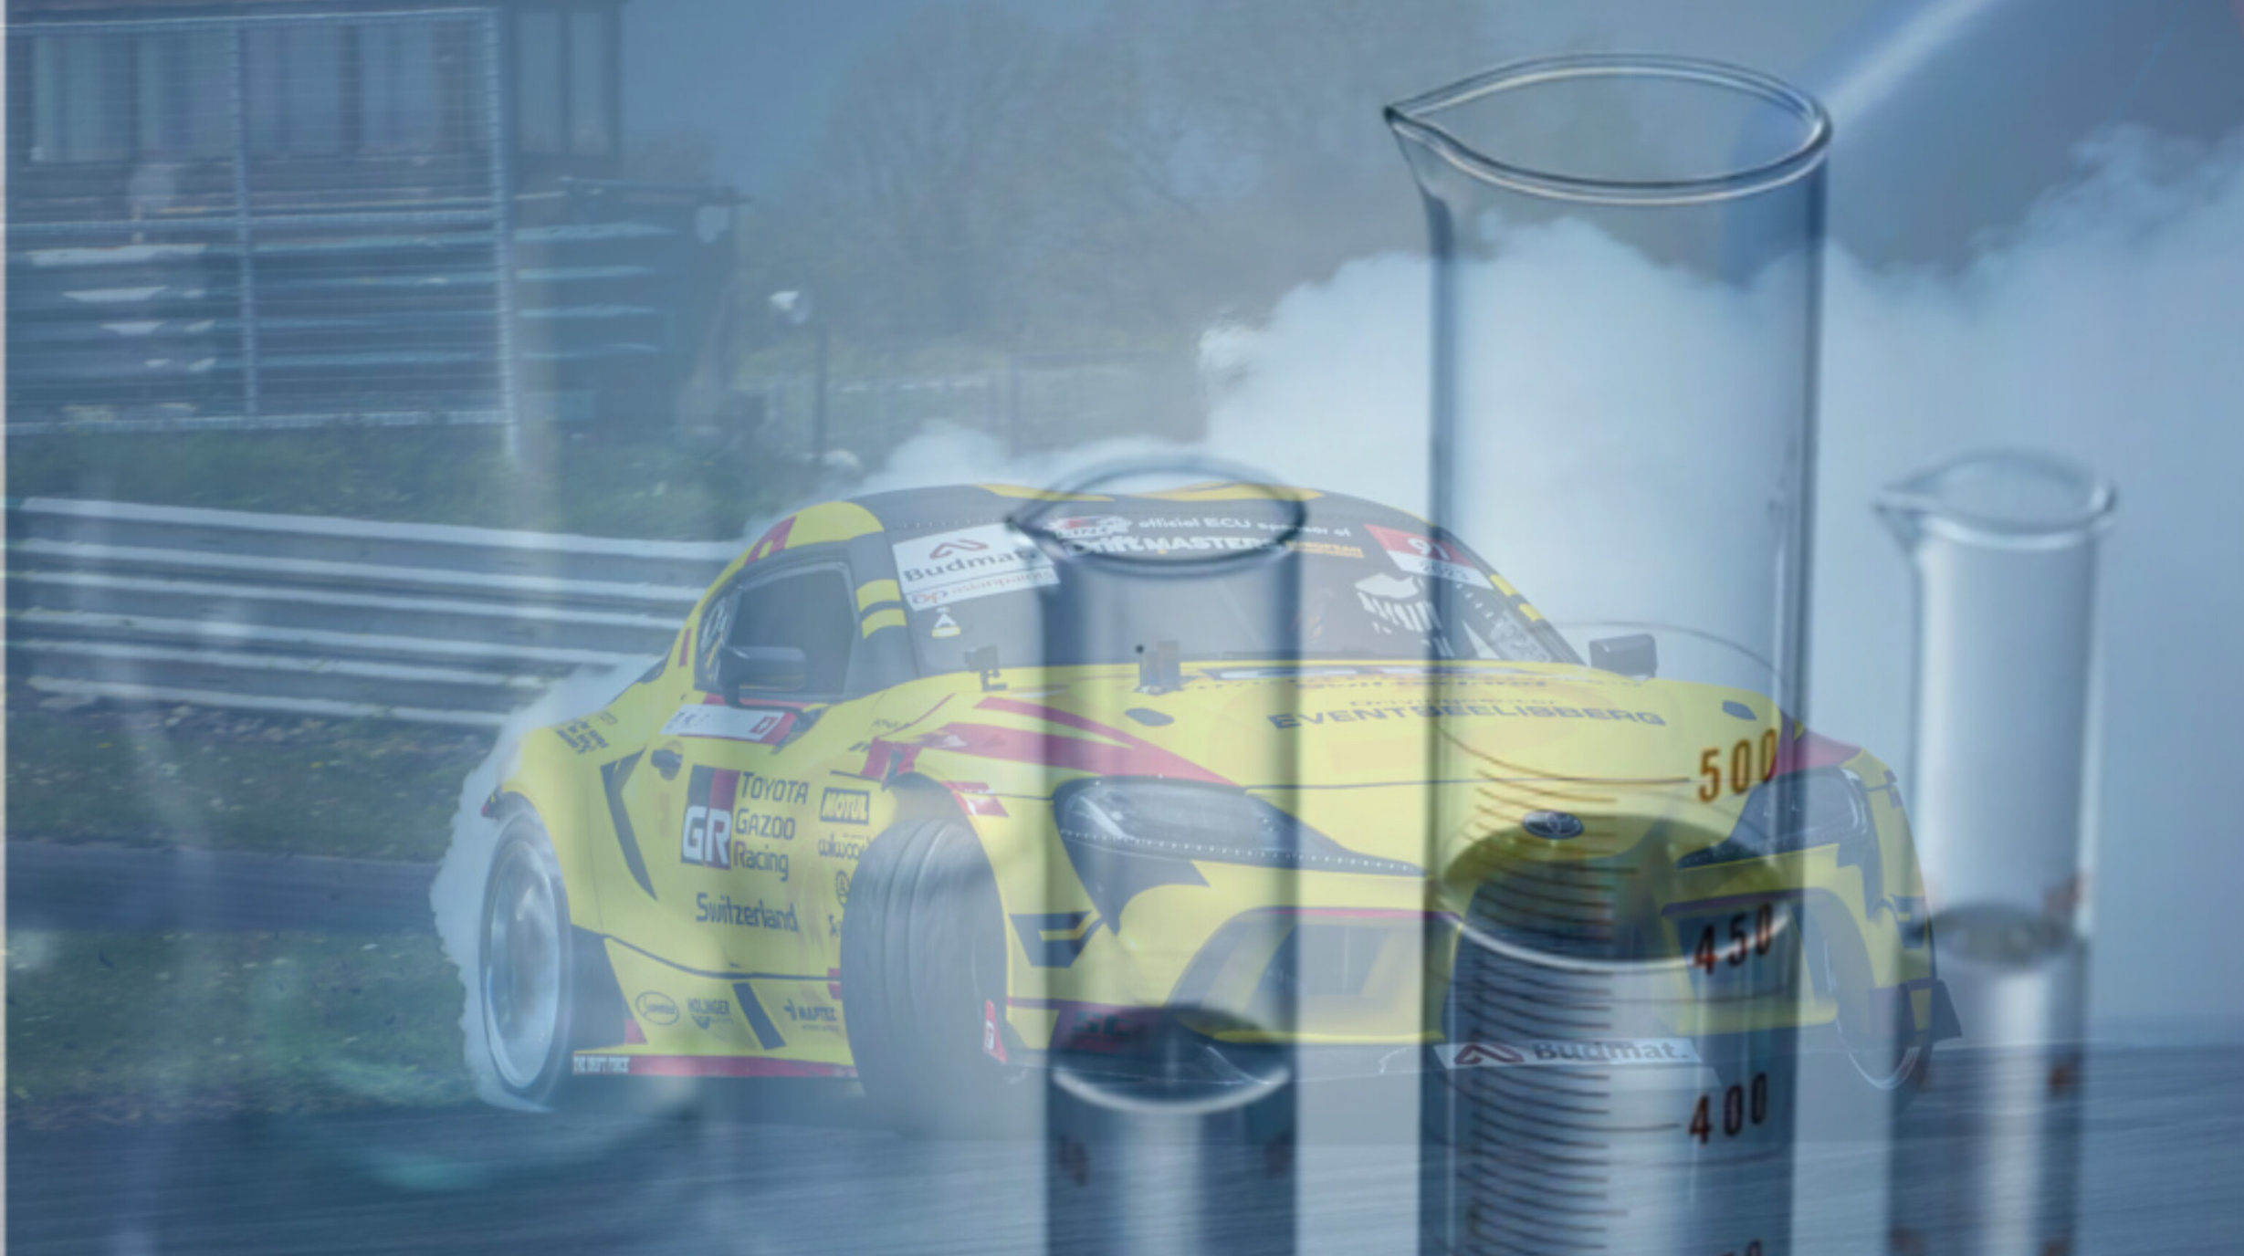
ETHANOL AND HYDROGEN CARS SHOW HOW CHEMISTRY CAN CREATE CLEANER FUELS AND INNOVATIVE TECHNOLOGIES FOR A SUSTAINABLE FUTURE. WITH FURTHER DEVELOPMENT, THEY COULD BECOME THE MAIN ENERGY SOURCE FOR THE CARS WE RELY ON IN THE FUTURE.
.
Thank you for your attention

